Slide 1

DATA MINING
AND
TEXT MINING
PROJECT
AA 2020/2021
920380
927879
938845
940651
Francesco Alongi
Stefano De Cillis
Sudarshan De
Mohamad Nezam
Notes:
Hello everyone, I am Francesco Alongi and with Stefano De Cillis we are going to present you our project of the data mining and text mining course.

Slide 2
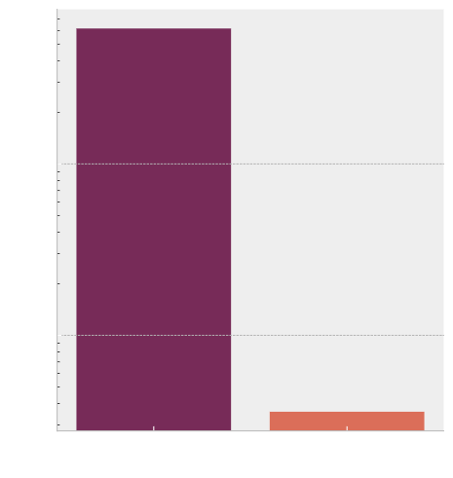
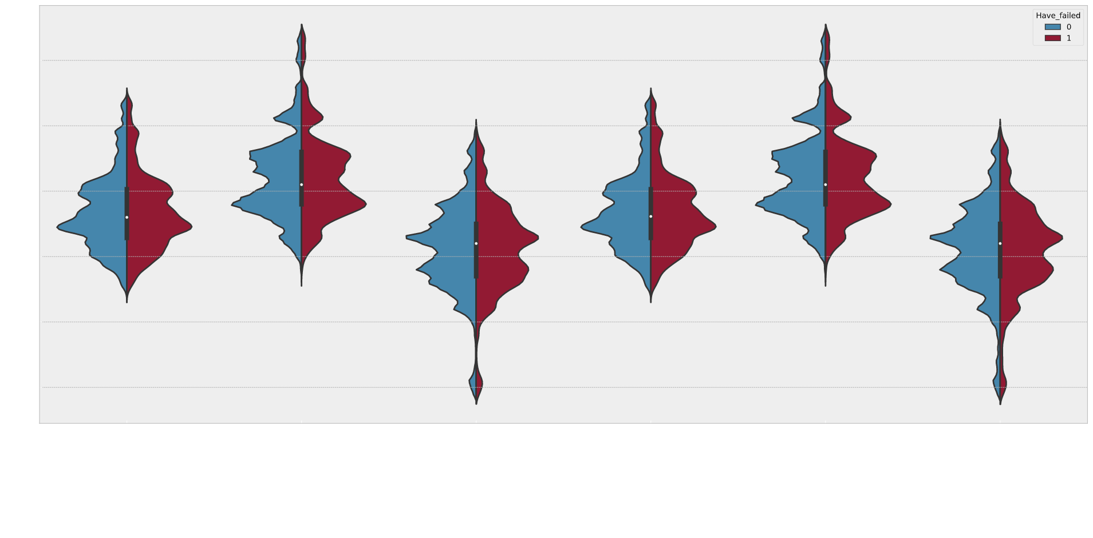
EXPLORATORY DATA ANALYSIS
TARGET BALANCING
Notes:
We started with a descriptive approach, exploring our data in order to gain a general understanding of their structure.
One of the earliest thing which has been noticed was that the target feature was not balanced, as can be seen in the left plot. Since this problem may harm the training phase, we decided to dive deeper into this problem in order to understand whether an undersampling could be performed without significative loss of information. In order to do so, we partitioned our dataset into two subsets: one containing samples of sites which air conditioning system have never failed while the other containing samples of sites which air conditioning system have failed at least once. In the right plot it is shown just one of the plot that we used for our analysis, in which it is possible to see that the distribution of the features are similar for both subsets. We concluded then that undersampling could be a viable trade-off.

Slide 3
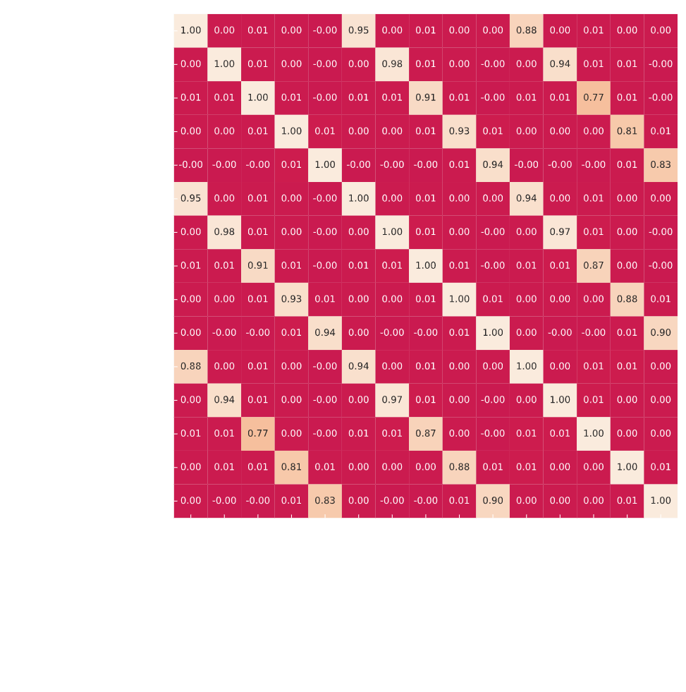
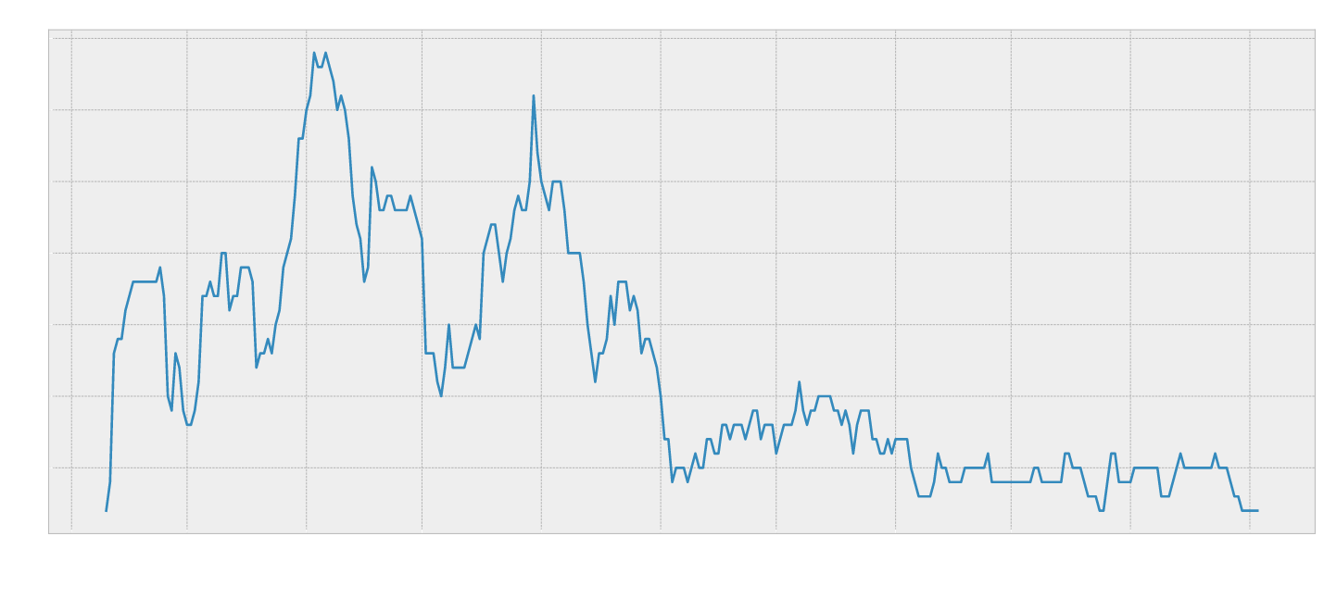
CORRELATION ANALYSIS & FAILURE’S TEMPORAL ANALYSIS
EXPLORATORY DATA ANALYSIS
Notes:
Then, our focus have moved towards the high dimensionality of the data. We performed a redundancy check via correlation analysis, highlighting the fact that some features carry almost the same information. In particular this happen because there are features which incorporate others because they refer to larger time spans. One example is shown on the correlation matrix on the left.
We tried also to understand the importance of the variable DATE. In the right plot we show the sum of the failures for all sites, and from this plot it is possible to see that there is a clear dependance on the month, meaning that it is likely to be a good feature, while instead the year might not be a good feature since we also have just two values.

Slide 4
FEATURE SELECTION
MODEL TRAINING
DATA WRANGLING
MODELS COMPARISON
MODEL SELECTION
Validate different models and find the best one
Adapt the dataset to the given use case
Pick unique features that best describe your data
Choose & train the deliverable model
Notes:
During model selection phase, we cleaned the dataset and adapt it to the use case following the insights found in the first part. Regarding feature selection, we didn’t have a prior knowledge therefore we selected the features in which the timespan taken into account were largest in order to have a long-range information with less noise. It’s important to say that to have an unbiased estimator of the test error, all the splits we performed on the dataset were made taking into account the SITE_ID and not raw samples. The training set has been upsampled and several models have been trained and validated using a modified version of the k-fold cross-validation. The considered models have been compared using a t-test which led us to choose the best model, which is Random Forest.

Slide 5
FINAL SCORE
Descriptive
Predictive
RANDOM FOREST
Weighted Recall
RESULTS
Discover hidden patterns in data
Gain knowledge about unknown features
Find redundant information
Deal with high data dimensionality
Find the appropriate metric for the situation (F1 and PR curve)
Design the pipeline for robust model selection
0,122
Notes:
Here it is the score which is 0.122 . On the left, we have the value the model scored during the final test with the metric selected in the requirements. On the right, instead, there are some final considerations. Given the results, we are happy about our descriptive part. In particular we learnt to find hidden patterns in data, gain knowledge about unknown features and deal with high data dimensionality. We are aware that the predictive part can be improved by a lot. We are satisfied about the environment we worked in.Once we applied the right test set, making a modified versions of k-fold and test split,we dropped our score by 80 % but we know it’s the real score we would have in a real scenario. In conclusion, we are aware that the second part of the project can be improved. Probably, with more experience and time, we would’ve obtained a better score.
Thank you all.

